Slide 1
Probability Basics
Probability Distribution
Using Distributions
Nonparametric statistics
Sampling distribution

Slide 2
Probability Refresher
Probabilities range from 0 (impossible) to 1 (certain)
Probabilities sum to 1
A distribution relates outcome x with probability p(x)
A mass function is for when you have discrete outcomes

Slide 3
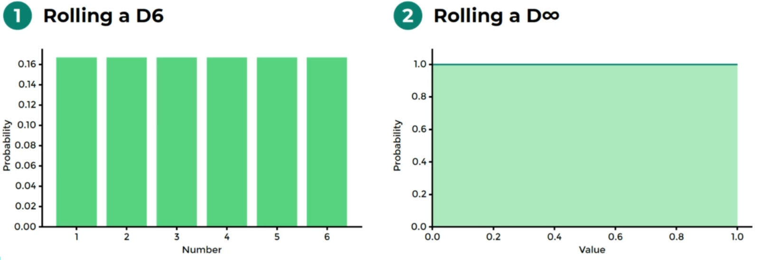
Notes:
0.2555555555555555, 0.000000000000000001 1/100000000000000000000000

Slide 4
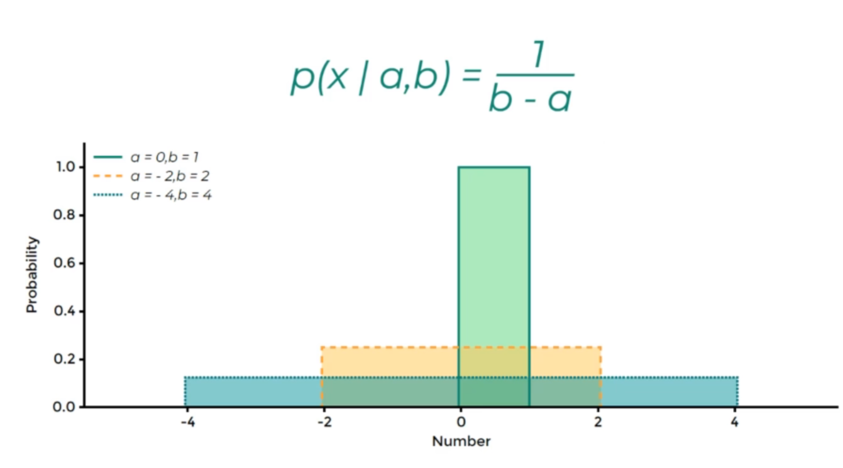
Uniform Distribution

Slide 5
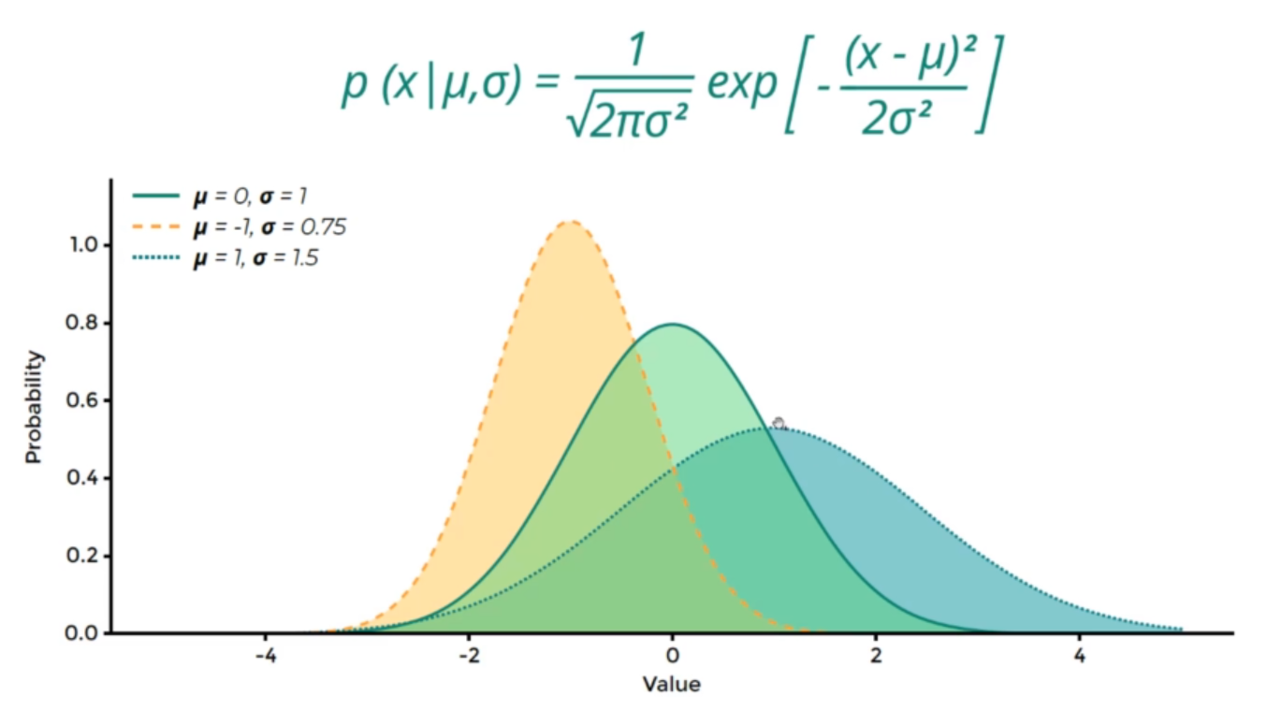
Normal Distribution
Notes:
Normal distribution, the area all the time is equal to one

Slide 6
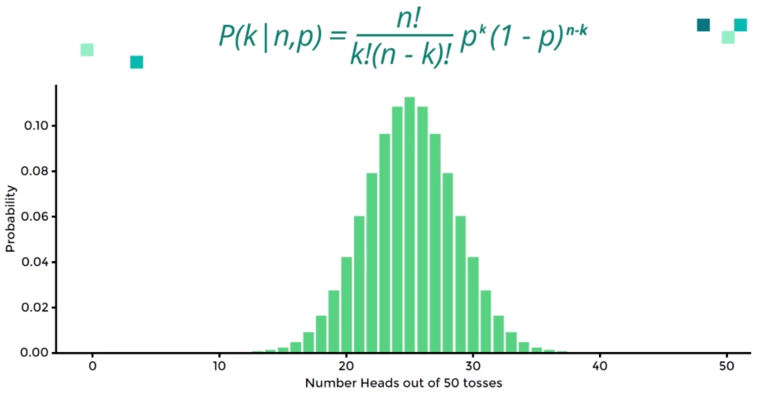
Binomial Distribution – independent
Notes:
Yes or no, positive or negative , head or tail….

Slide 7
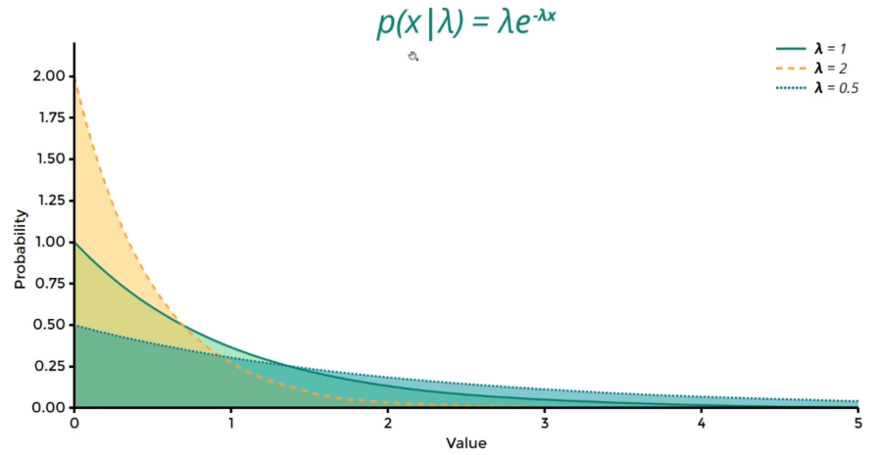
Exponential Distribution
Notes:
Product age,

Slide 8
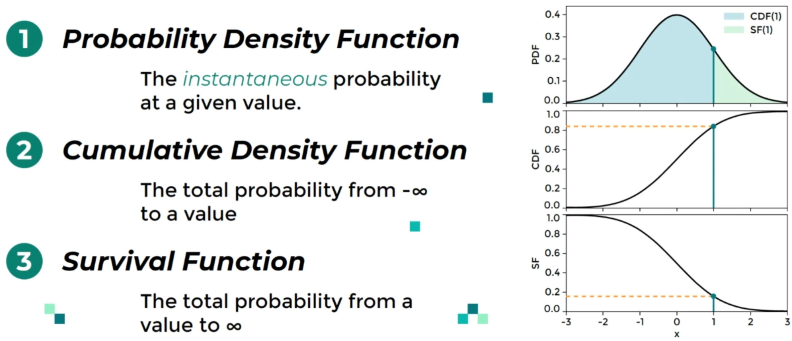
Using Distributions

Slide 9
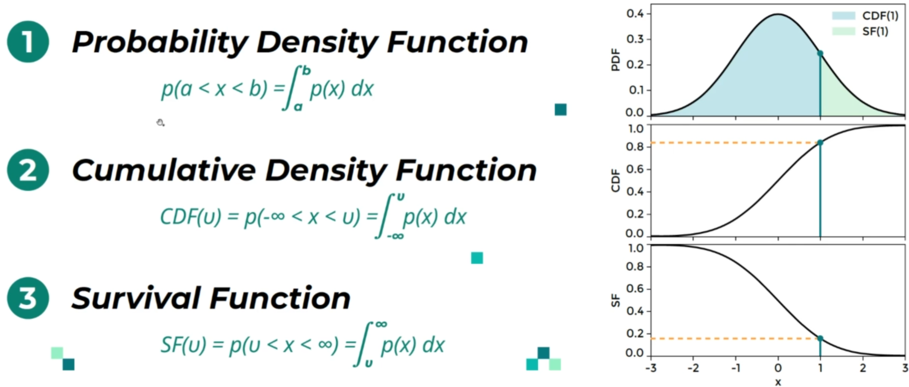
Generalizations

Slide 10
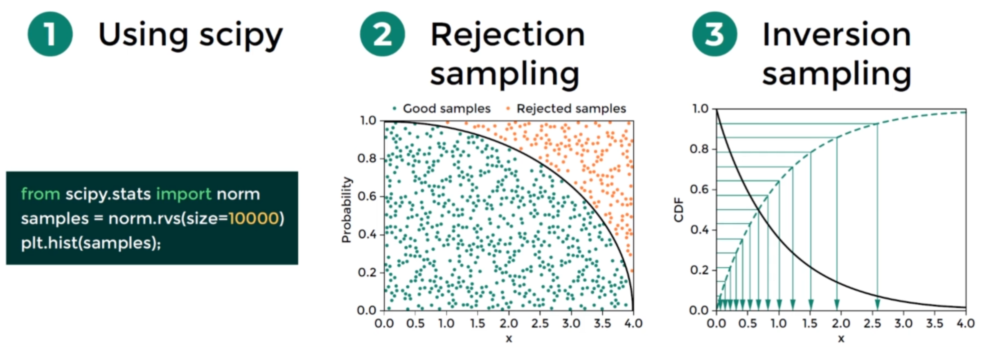
Sampling Distribution
Notes:
continuous random variable sampling

Slide 11
What is Hypothesis Testing
Hypothesis testing is the ability to ask and quantitatively answer questions.
More formally, if you formulate two hypotheses, how confidently can you point to the true one

Slide 12
Examples
Tom is wining a lot at dice, are his dice Loaded?
Does a vehicle meet emission standard
Is there evidence of election fraud
Does an in coming patient has covid19
What is the chance that a giant asteroid will hit the planet in the next thousand years?

Slide 13
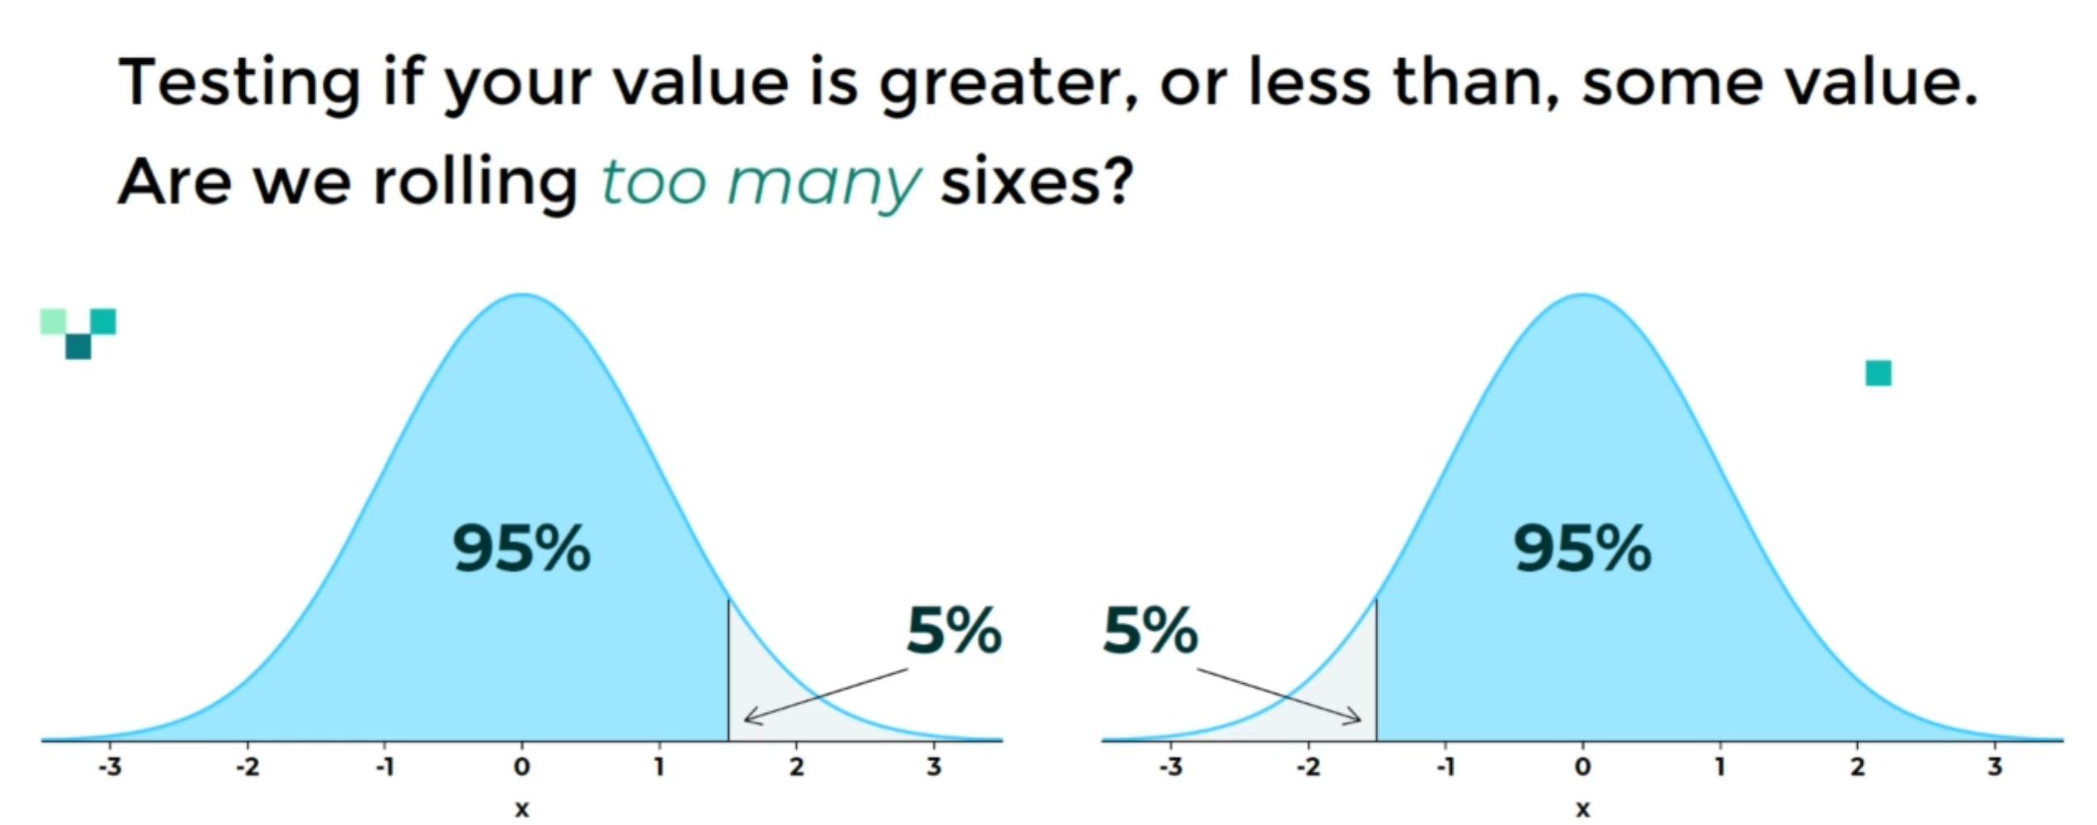
One_Tailed Test

Slide 14
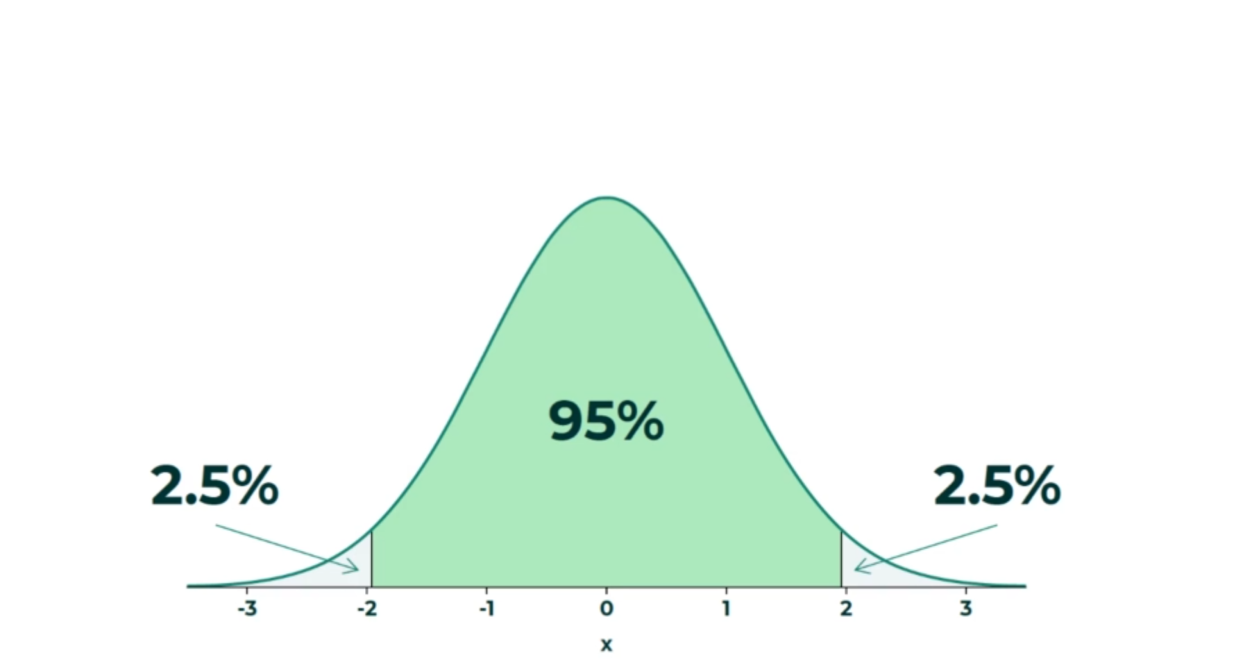
Two_Tailed Tests

Slide 15
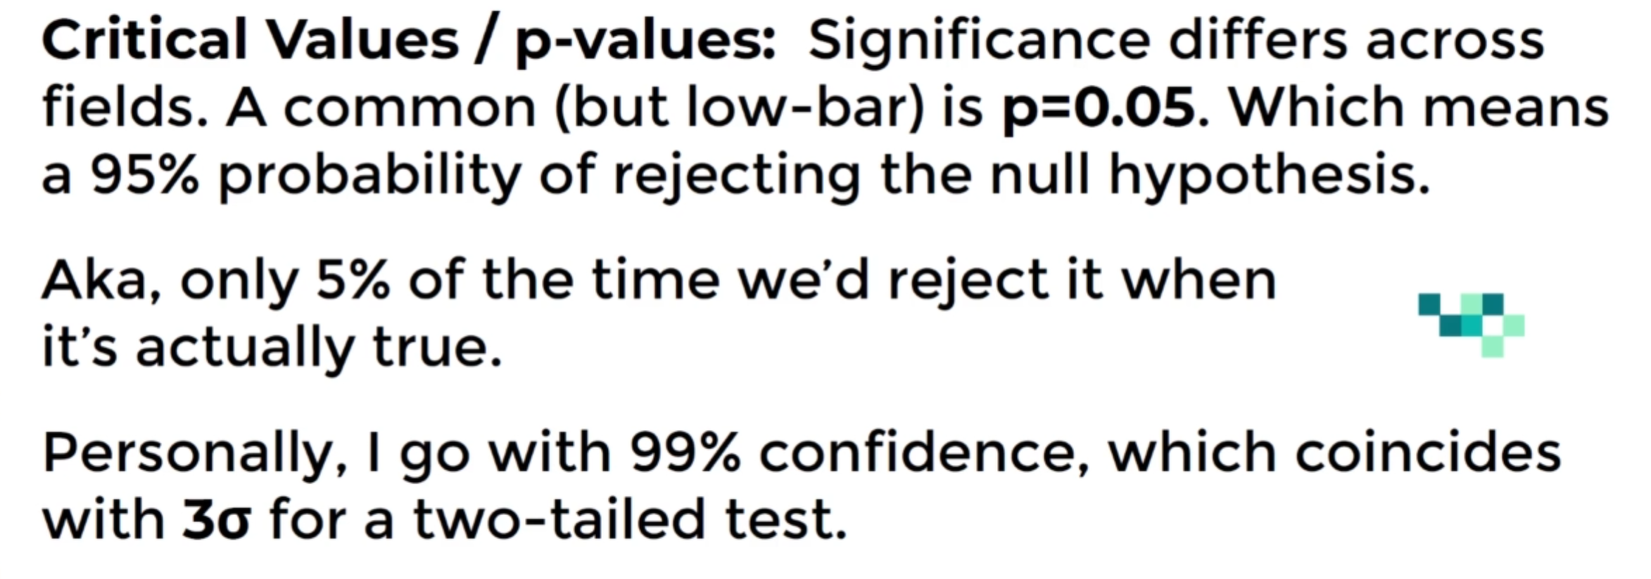

Slide 16
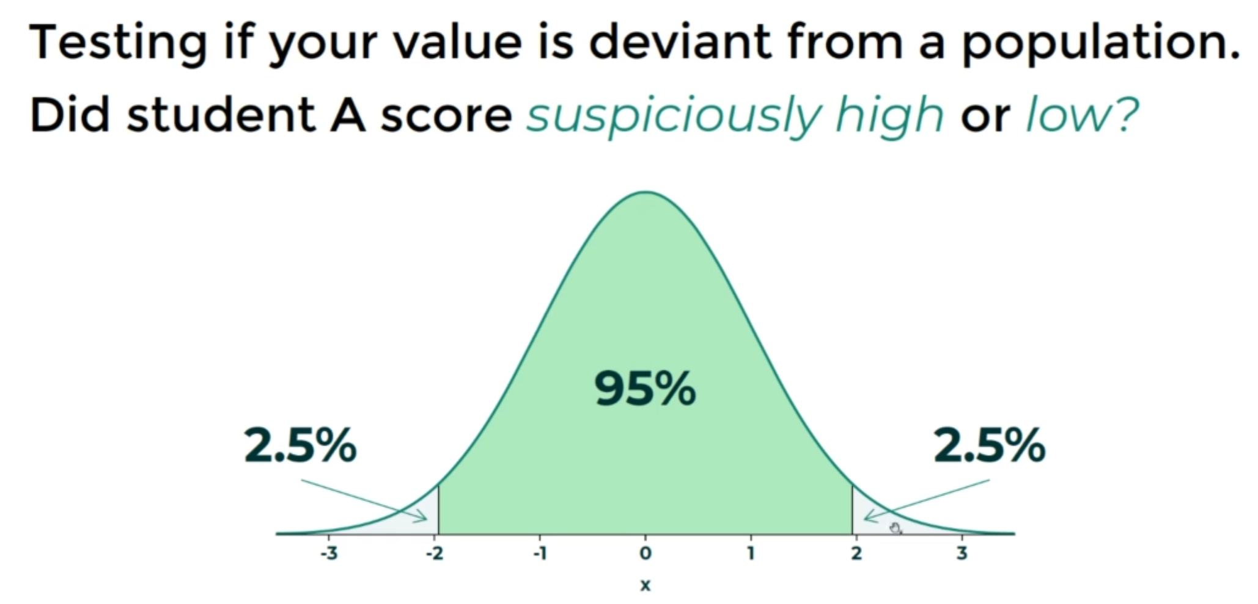

Slide 18
Z-Score

